Slide 1

PMAS-Arid Agriculture University Rawalpindi University Institute of Information Technology
DEEP LEARNING BASED CHATBOT
Group Members:
1. Sheharyar Kalim
2. Natalia Nisar
3. Faizan Khan
17-Arid-1574
17-Arid-1557
17-Arid-1466
Supervisor:
Mr./Ms./Dr. Zeeshan Javaid

Slide 2
Agenda
Introduction
Existing System
Problem Statement
Proposed Solution
Project Scope
Project Objectives
Diagrams
Use case
Sequence
Activity
Class Diagram
ERD
Deployment
Component
Package
Tasks Distribution
Tools and Technologies
Screen Shots
Notes:
Number of Diagrams will be according to Supervisor

Slide 3
Introduction
Chatbots are intelligent agents which have ability to understand the spoken language and use speech communication as user interface
Chatbots can answer the queries of customers but this couldn’t be achieved just by the employees, a system has to be built in order to cater these specific needs
Chatbots streamline interaction between people and services and enhances customer experience
It provides an opportunity to improve customer engagement. Companies can get real insight into what they’re costumers prefer, and therefore provide improved offers and answers to their users
There’s lots to be learned from most searched and used words in regards to what interests the users most. In a world where mobile and digital are first and musts it makes little sense for companies looking to succeed to no harness the benefits of deploying chatbots as a key tool to strengthen their relationships with their clients both internally and externally.
Notes:
Only Bullets no need to add paragraph on all slides

Slide 4
Existing System
WHO: First in our list of chatbots is The World Health Organization (WHO). WHO built a bot on WhatsApp called the WHO Health Alert to share information related to the pandemic
Insomnobot: a conversational agent that aims to give insomniacs someone to talk to while the rest of the world rests easy.
MedWhat: This chatbot aims to make medical diagnoses faster, easier, and more transparent for both patients and physicians – think of it like an intelligent version of WebMD that you can talk to
Notes:
Add Figures where ever necessary to explain the system

Slide 5
Problem Statement
Companies have to hire more staff in order to resolve customer complaints
Communication issues between user and Chatbot.
Accuracy level is not fulfilling the requirements. communication barriers.
Some Chatbots only understand formal language which causes misunderstanding.
Chatbots are provided with input through texts which is then analyzed with NLP tools and thus provides the desired response.

Slide 6
Proposed Solution
Proposing a solution which will resolve the traditional problems facing by the companies or business enterprises is to develop a system named Smart Chatbot
It will use NLP for language processing we will train our system with data set to use it with NLP
Smart Chatbot will take input from the user in form of text or speech then process the input using NLP with the trained data set
Our system will process both text and speech given by the user. To make the system user friendly we will use Tkinter for User Interface.

Slide 7
Project Scope
Our smart chat bot will communicate with people by typing or by speech. As there are many chat bots working but they can’t response to the commands which contain errors
Our Smart chat bot will try to understand the command even if it contains some grammatical or typing errors; this will make it even more easier for a people and much more time saving
It will contain two types of input speech and text
Our Smart Chatbot will be designed in an intelligent and superefficient manner that it will be compatible with different applications and websites.

Slide 8
Project Objectives
Our project aims to provide a deep and detailed learning of chatbots that exist in this environment. Simultaneously, we will be providing the specifications of the existing chatbots and how they are being evolved as per the requirement of time and different companies
Our smart chat bot will communicate with people by typing or by speech. As there are many chatbots working but they can’t response to the commands which contain errors
Our smart chat bot will understand the command even if it is not totally correct. Our smart chatbot will take command from user in the form of speech or text, process the data using trained data set and communicate with the user

Slide 9
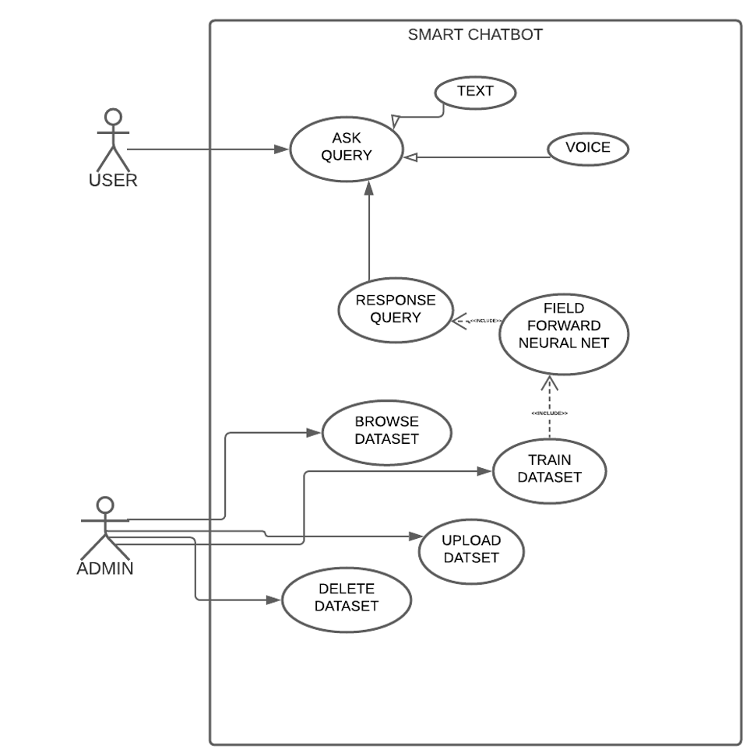
Diagrams…(Use Cases)
Notes:
All diagrams will be in PDF and their hyperlinks should be here to make it more visible

Slide 10
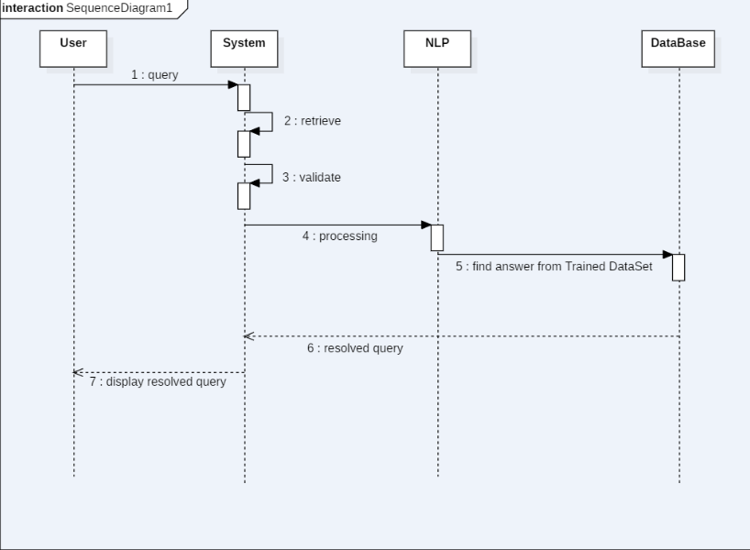
Diagrams…(Sequence)

Slide 11
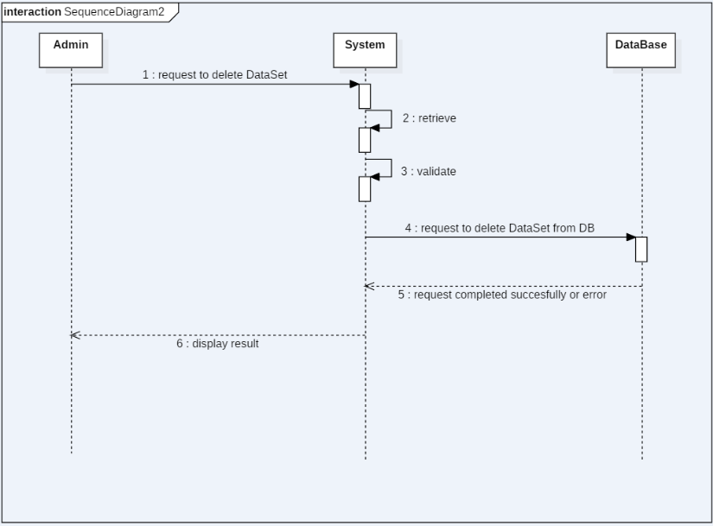
Resolve Query

Slide 12
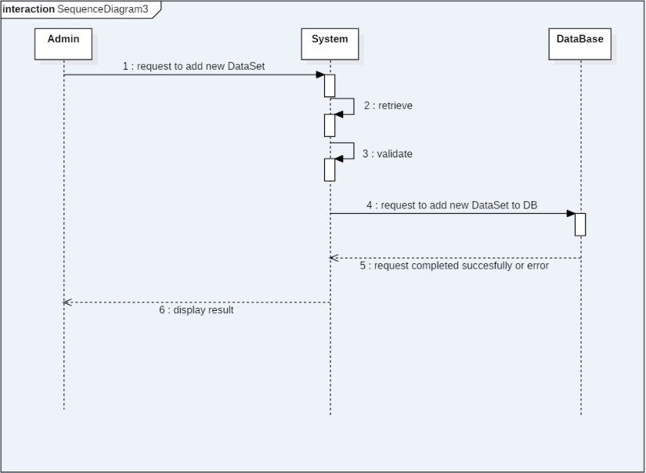
Add Dataset

Slide 13
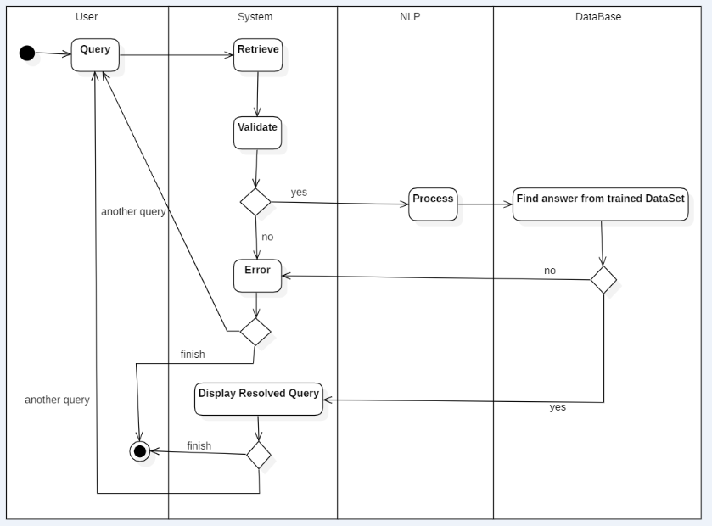
Diagrams…(Activity)
Query

Slide 14
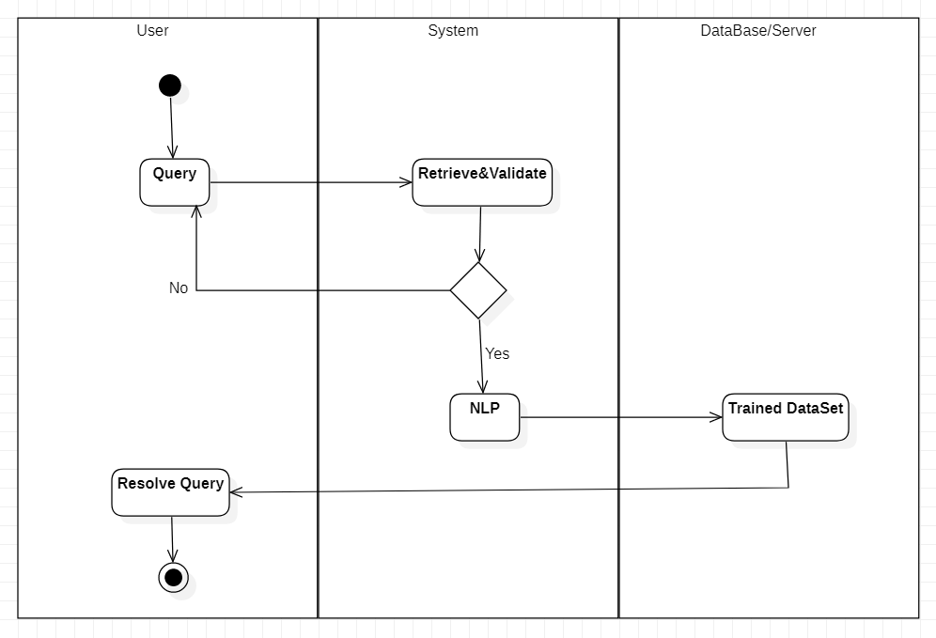
Resolve Query

Slide 15
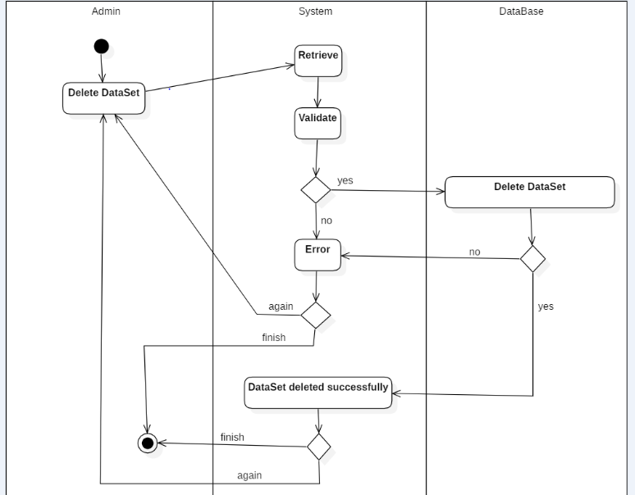
Delete Dataset

Slide 16
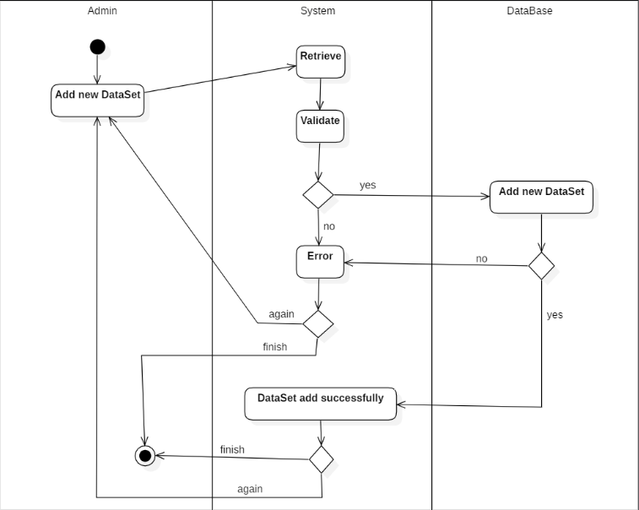
ADD Dataset

Slide 17
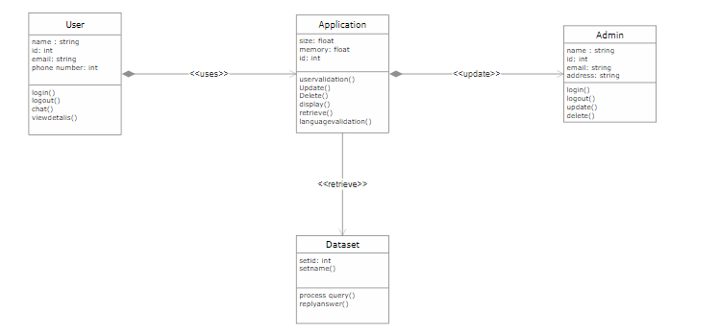
Diagrams…(Class)

Slide 18
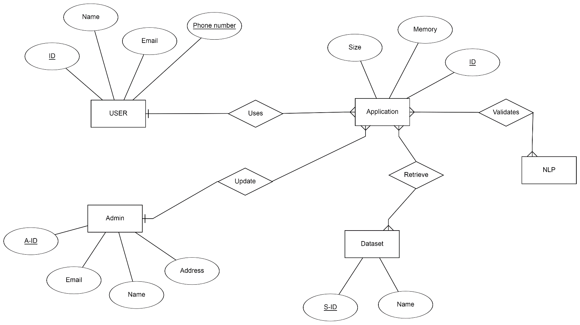
Diagrams…(ERD)

Slide 19
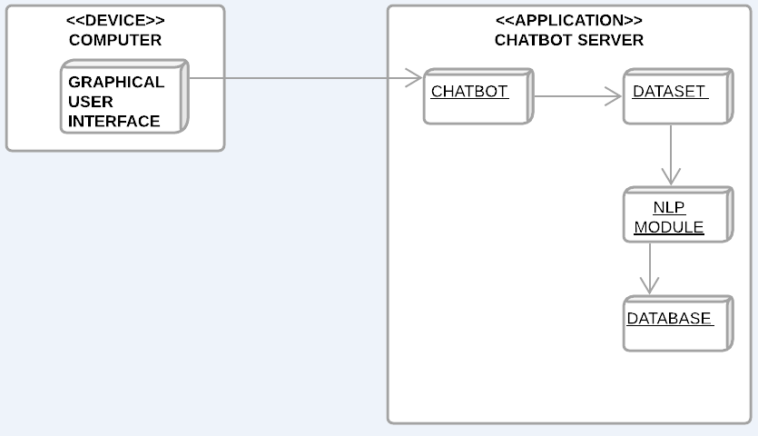
Diagrams…(Deployment)

Slide 20
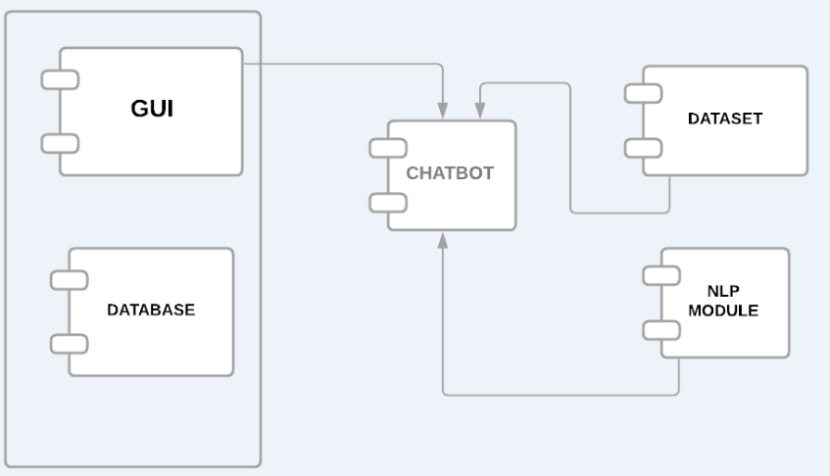
Diagrams…(Component)

Slide 21
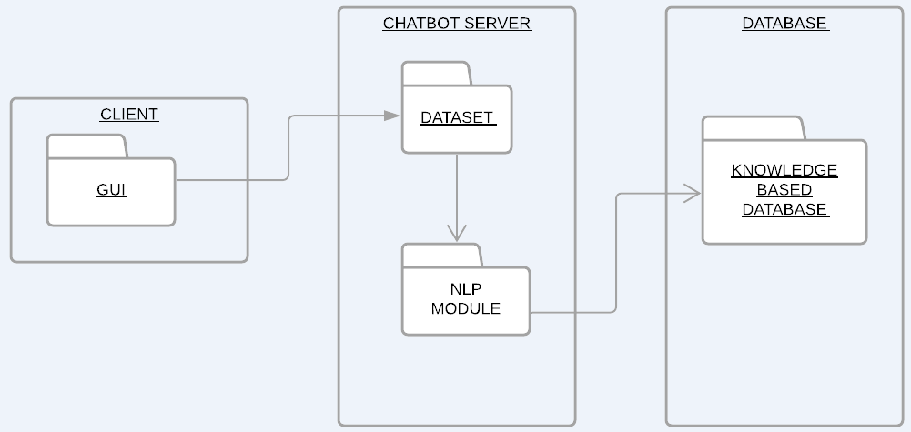
Diagrams….(Package)

Slide 22
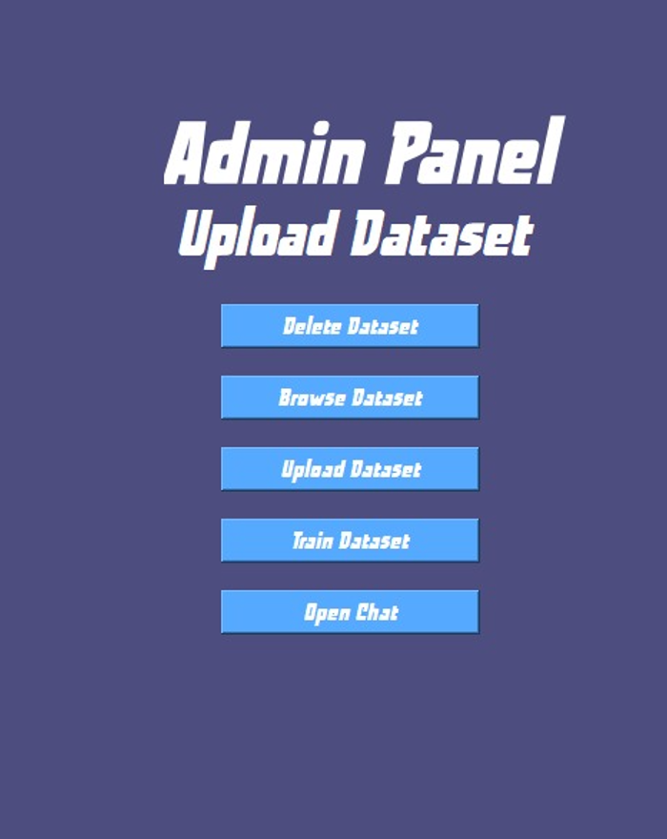
Admin Panel

Slide 23
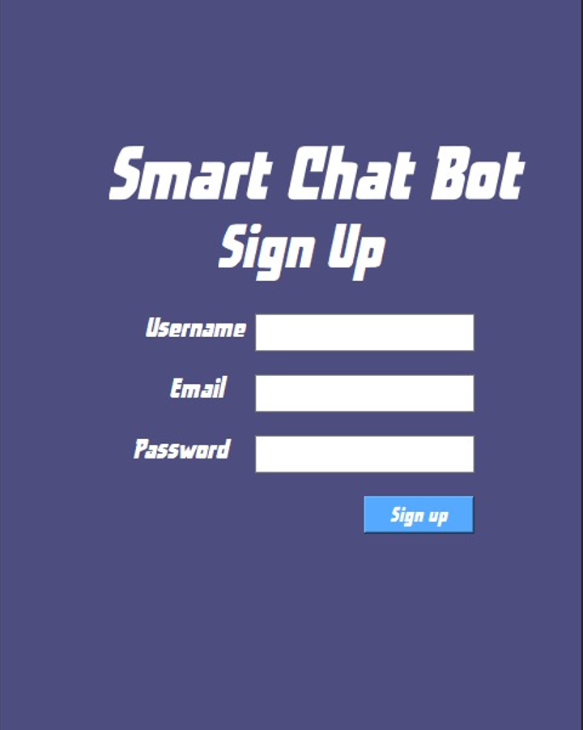
Signup Panel

Slide 24
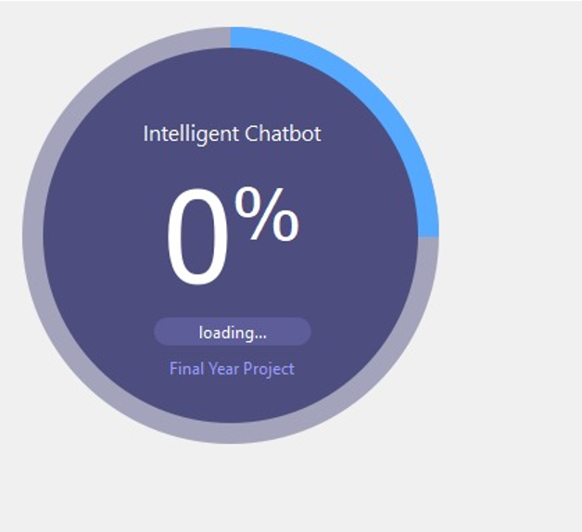
Loading Chatbot

Slide 25
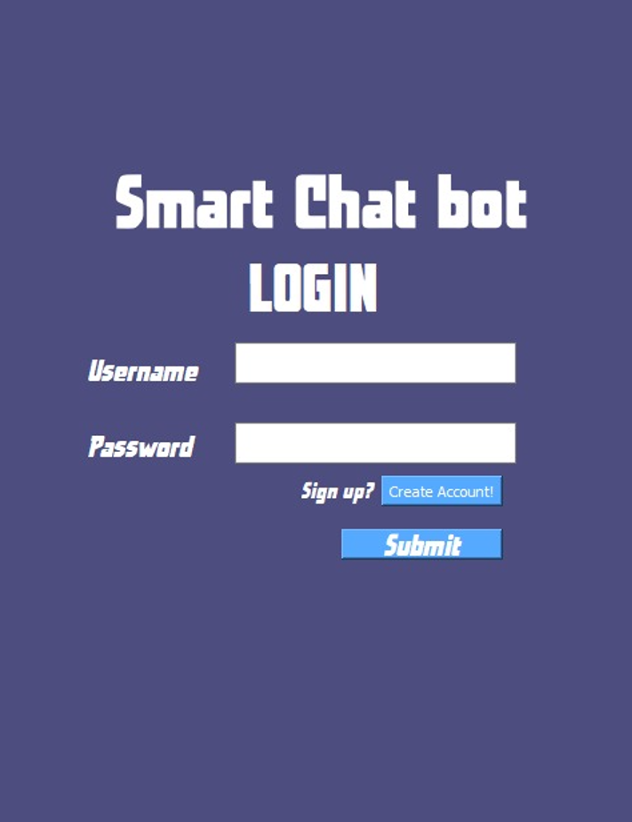
Login Panel

Slide 26
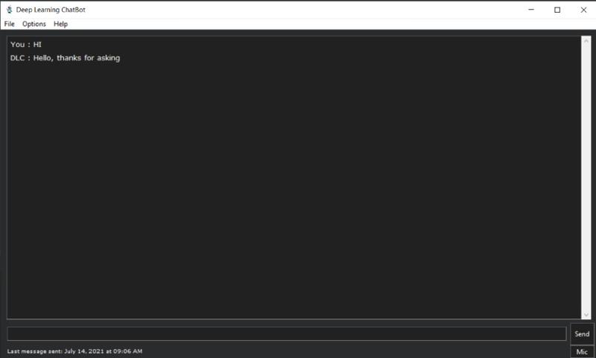
User Interface

Slide 27
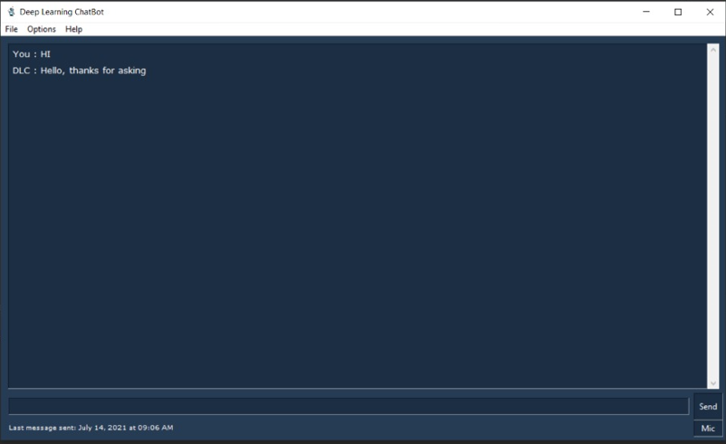

Slide 28
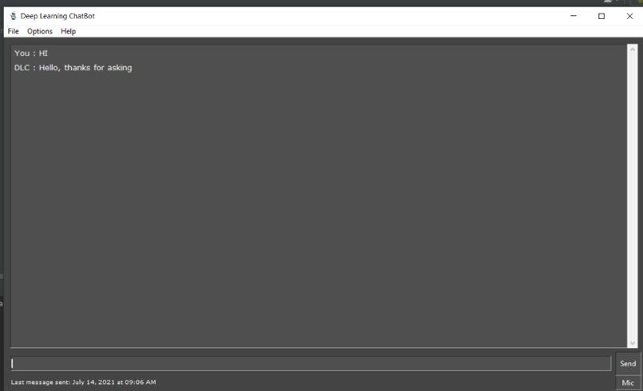

Slide 29
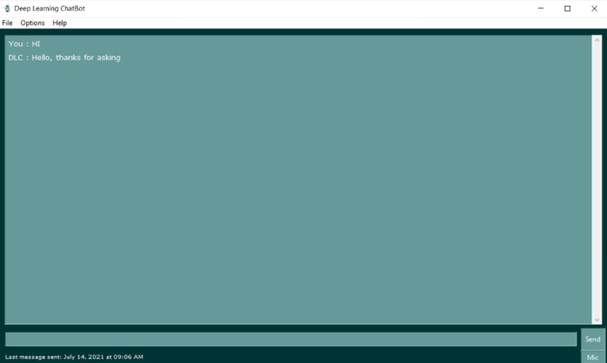

Slide 30
Conclusion
Our FYP project is about developing a SMART Chatbot, which would allow the user to interact and ask queries.
Our main focus was to create a chatbot based on deep learning, which would automatically store the data of the datasets and the queries asked by user. Till now we are able to create a manually trained chatbot, which can work through audio and text input. The user can give audio input as well as text input, to which the chatbot would response effectively. Till now the chatbot is working efficiently. Datasets are being uploaded through which the chatbot would be further trained for further functionality.

Slide 31
Future Work
The future work is that we would focus on uploading large datasets, and make the chatbot work efficiently.

Slide 32
Task Distribution
The tasks assigned to the group members were: Sheharyar Kalim will be handling the backend development, Faizan Khan will be developing the frontend that is the Graphical user-interface and Natalia Nisar will be handling the frontend and research-based work.
Notes:
Module distribution among students

Slide 33
Tools and Technologies
TOOLS
PyCharm
MySQL
PyQT5 Designer
XAMMP
MS Word
Technology
MYSQL
Python
PyQT5
Chatterbot
Tkinter
Speech Recognition
Threading
Notes:
Tools, Language, System Specs etc.

Slide 34
